Slide 1

AI IN MENTAL HEALTHCARE

Slide 2
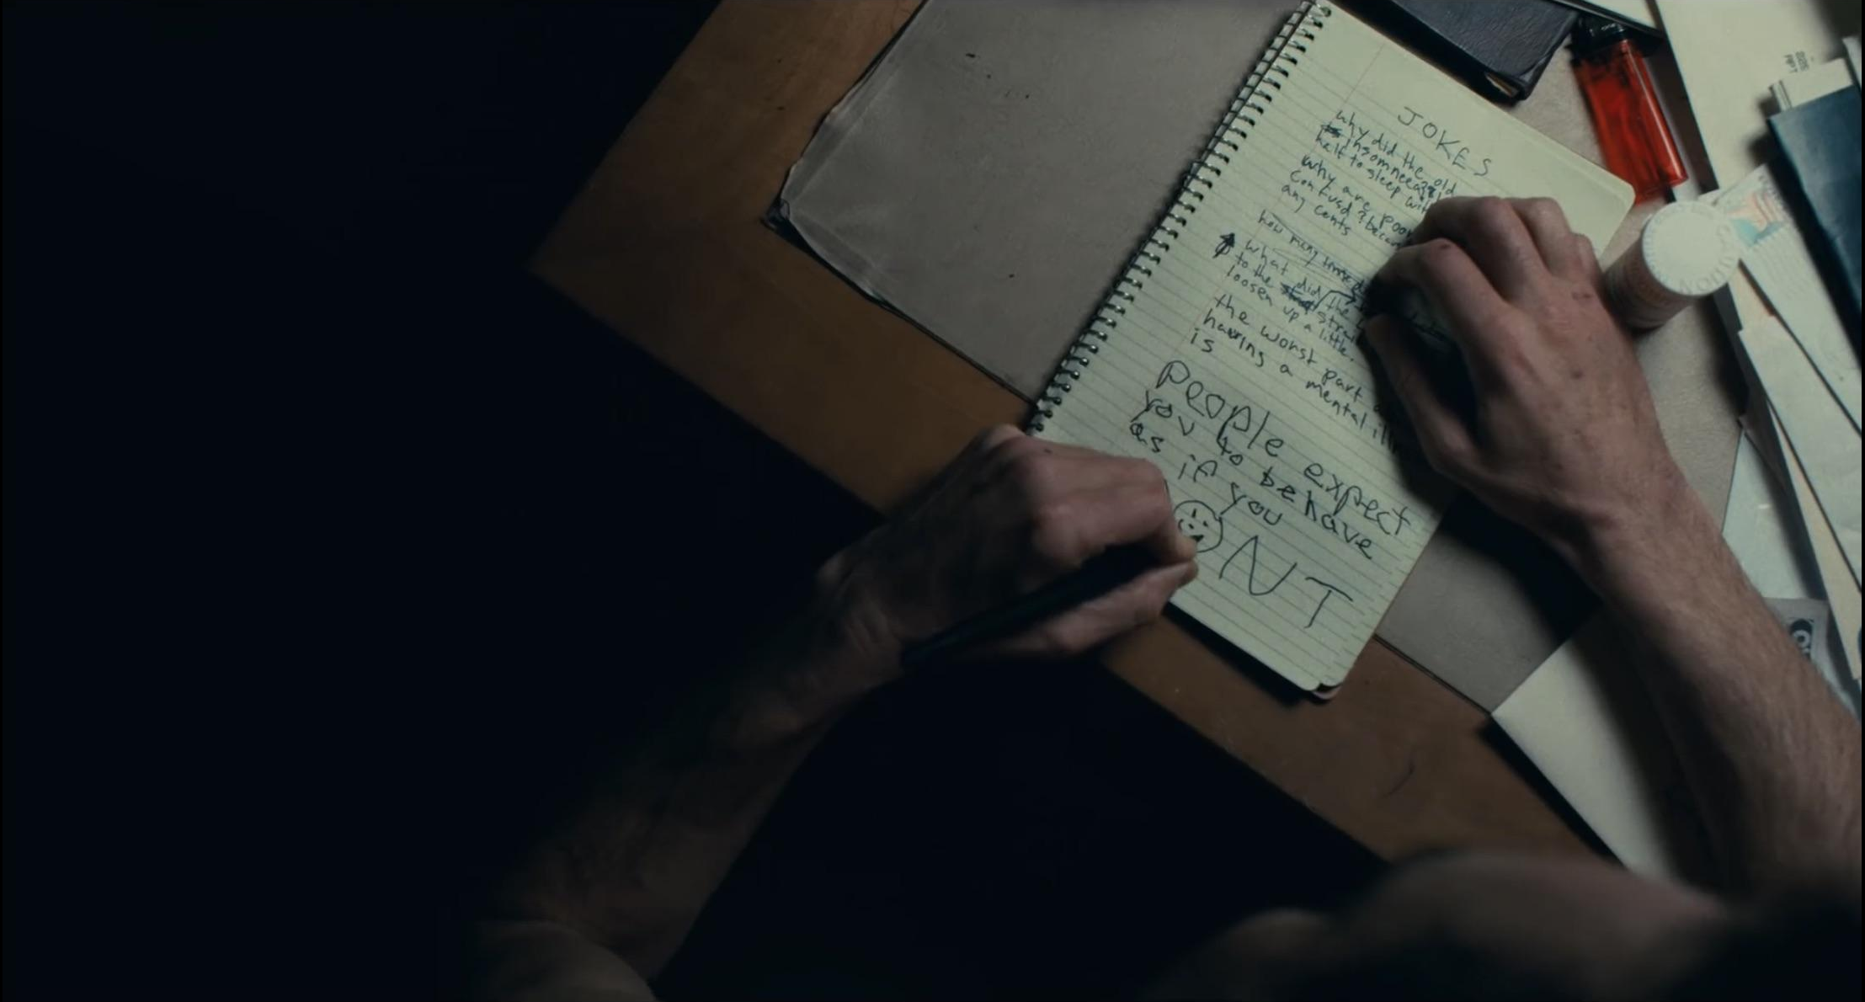
INSPIRATION
Forever alone in a crowd, failed comedian Arthur Fleck seeks connection as he walks the streets of Gotham City. Arthur wears two masks – the one he
paints for his day job as a clown, and the guise he
projects in a futile attempt to feel like he’s a part of the world around him. Isolated, bullied & disregarded by society, Fleck begins a slow descent into madness as he transforms into the criminal mastermind known as The Joker.

Slide 3



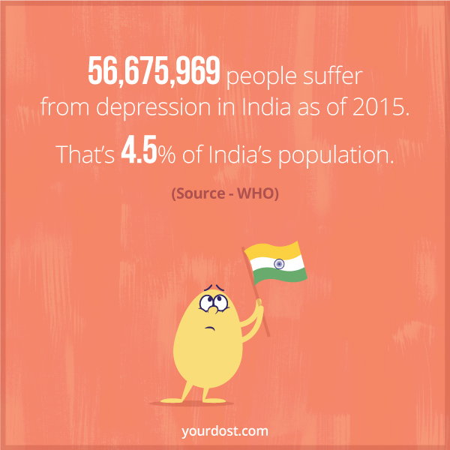
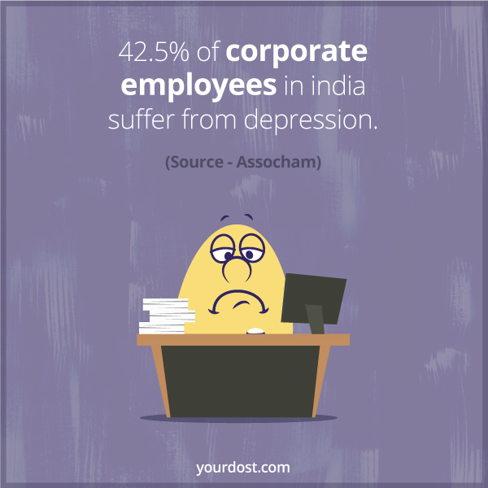
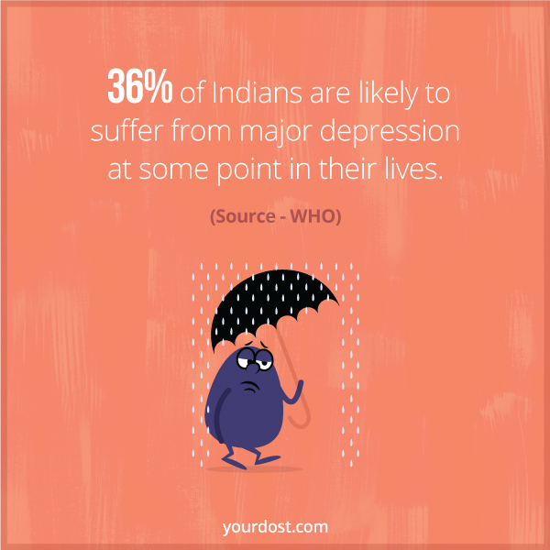
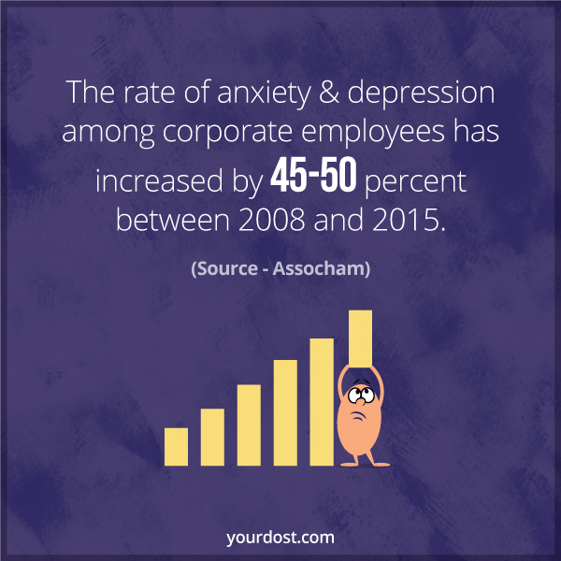

Slide 4

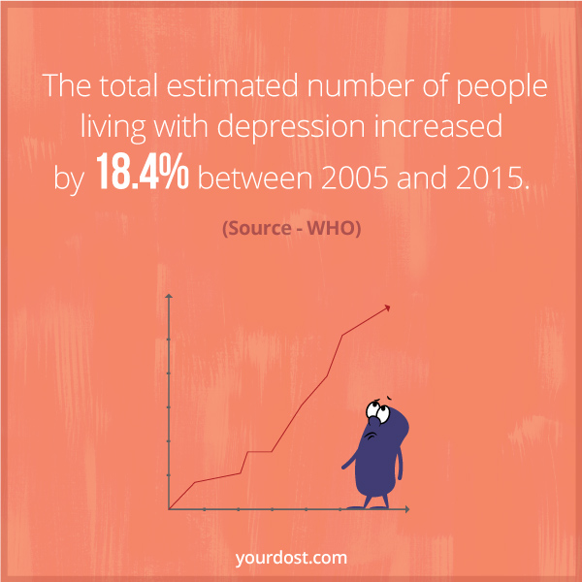
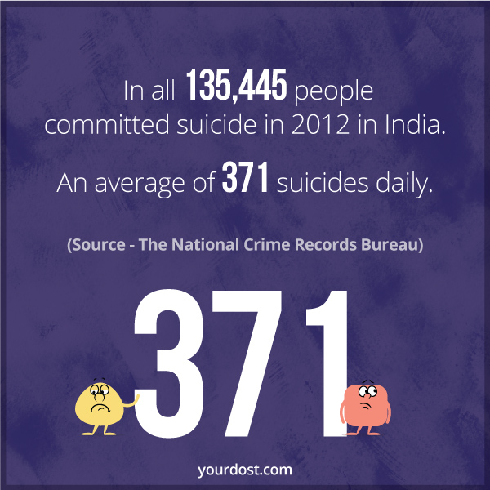

Slide 5


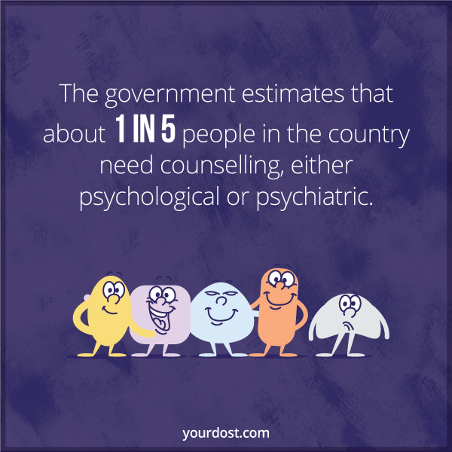

Slide 6

IDEA
A set of 10 questions will be used to calculate a score which decides whether an individual is under clinical depression or not.
The higher the score, the more the app will monitor the individual’s activity

Slide 7
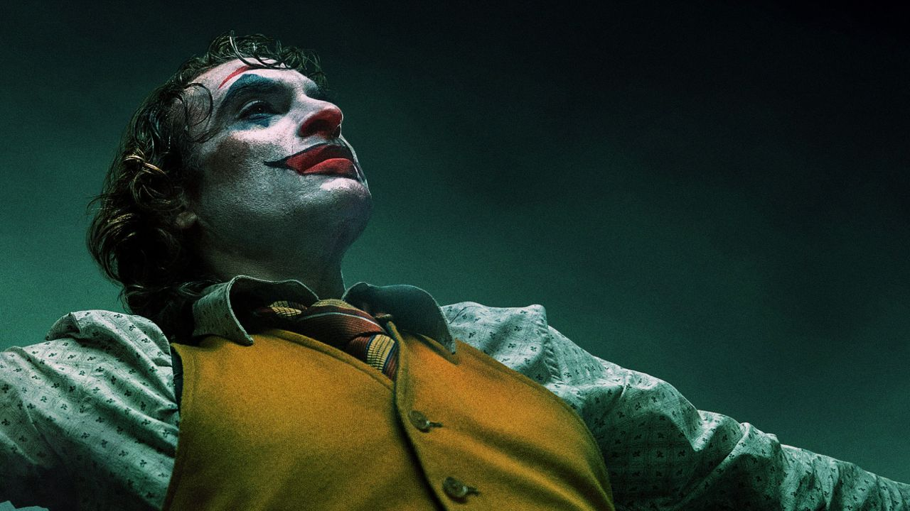
The main objective is to integrate these questions with a pre-existing healthcare app with will monitor the individual’s daily activities.
The score of an individual of a particular month will be stored in the app which will be compared with the score of the next month.

Slide 8
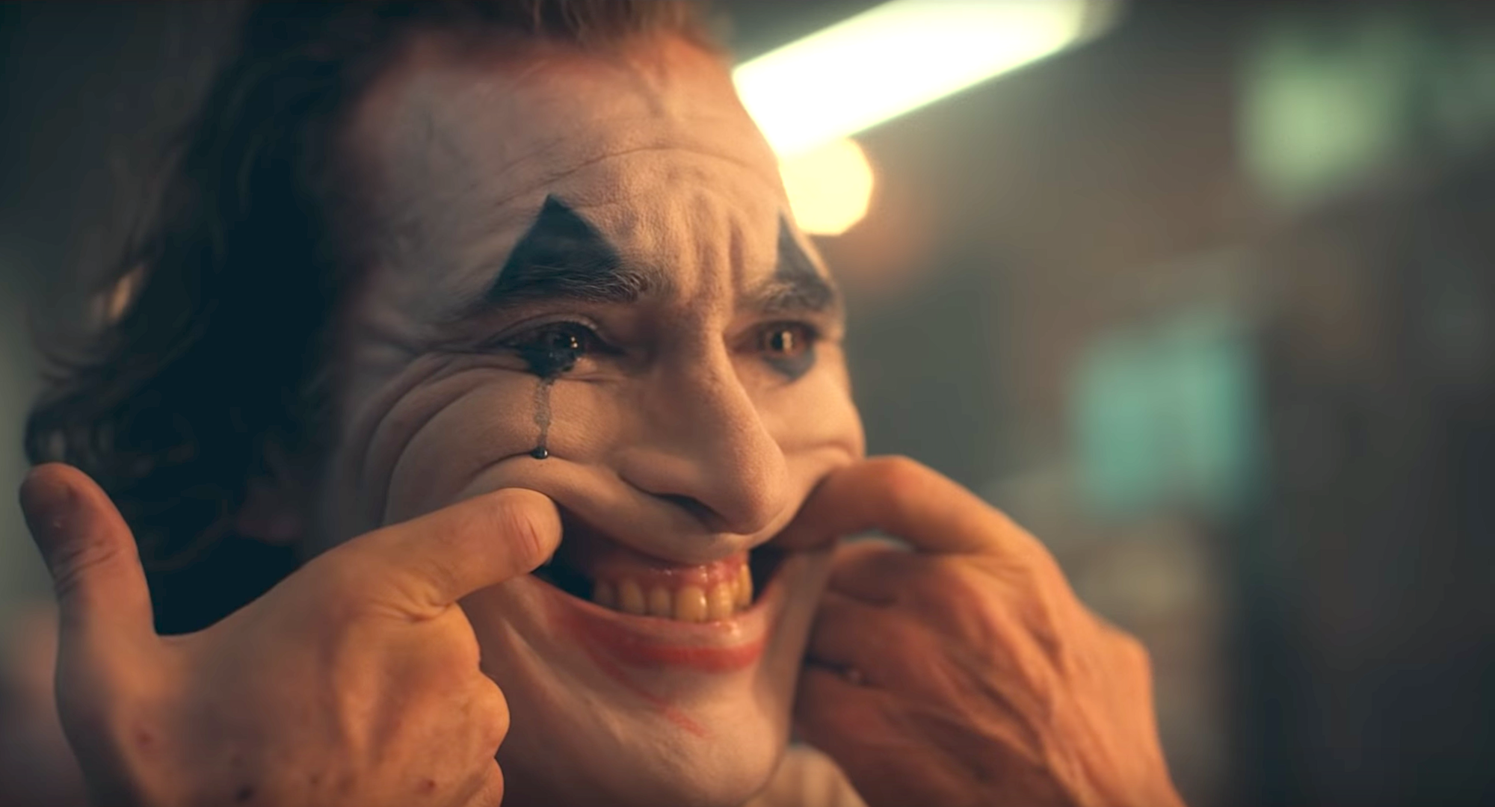
A situation when the score of an individual is too high, the nearby psychiatric services, suicide prevention & rehabilitation centres will be notified.
The questions will be asked based on the users’ recent activities/searches so that it has a better impact. The user won’t be notified about the score or his mental state.

Slide 9
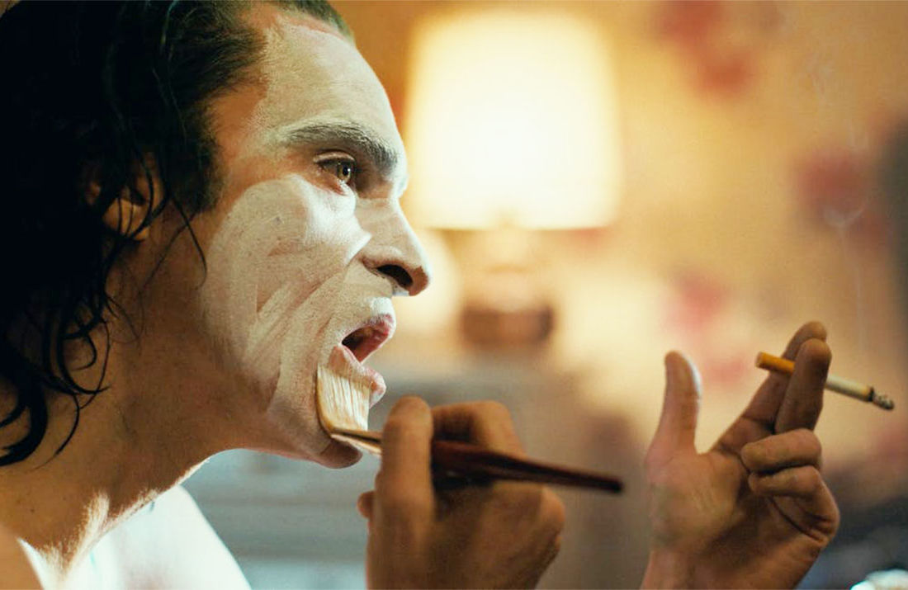
An Example Question
If you have a mental health condition, do you feel that it interferes with your work?
Never
Sometimes
Really
Often

Slide 10
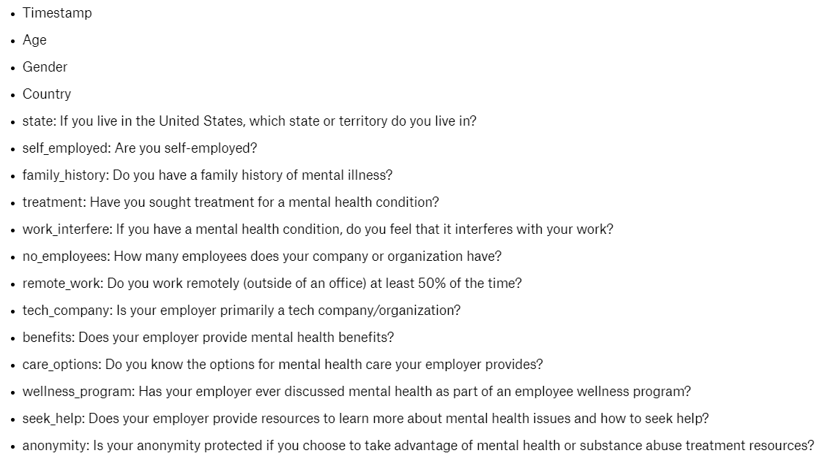
About the Dataset
Some of the variables

Slide 11
Data Preprocessing
→Changed ‘Gender’ variable classes into m, f, & o denoting male female and others repectively.
→Changed the Categorical variables which had 2 classes such as Yes or No into 0 & 1.
→Changed the Categorical variables which had 3 ordinal classes such as Yes,Don’t Know or No into -1,0 & 1 respectively.
→ Changed the Categorical variables which had 5 ordinal classes such as Very difficult, Somewhat difficult, Don’t know, Somewhat easy or Very easy into -2,-1,0 ,1,2 respectively.

Slide 12
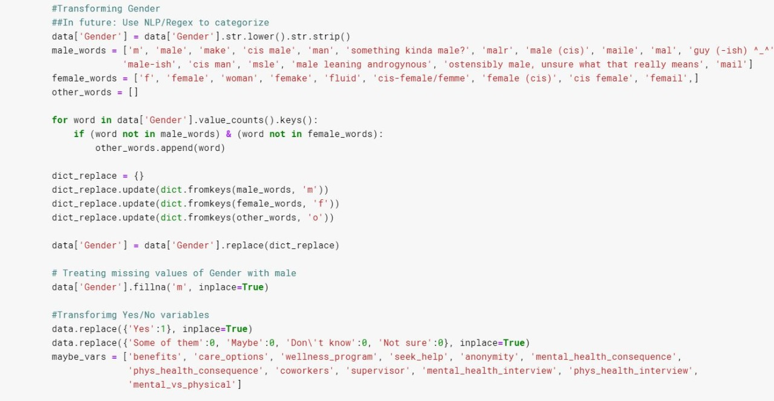
Code Snippet

Slide 13
Accuracy Scores of different models
Logistic Regression | 84.21 | 84.12
Decision Trees Classifier | 83.86 | 83.54
Random Forest Classifier | 85.06 | 85.13

Slide 14
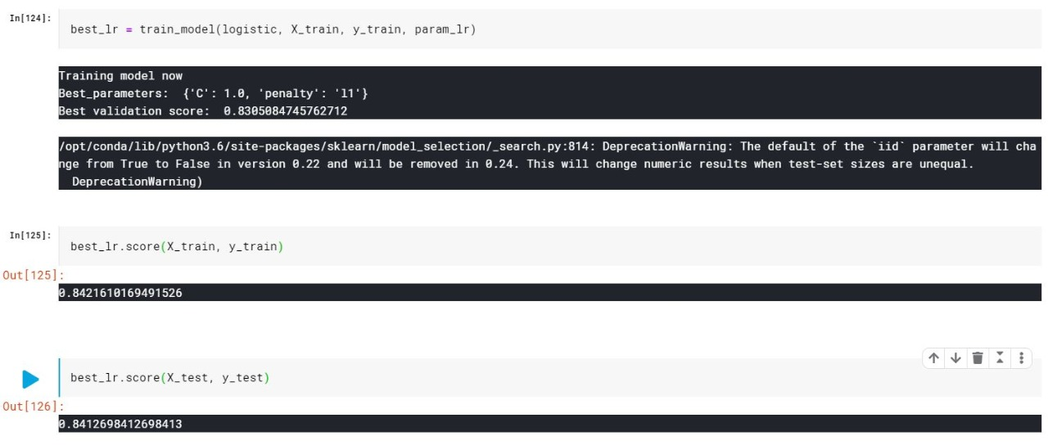
Accuracy of Logistic Regression

